Slide 1



Sales Analysis
Trends and challenges

Slide 2

Introduction
Amazon was founded on July 5, 1994, by Jeff Bezos in Bellevue, Washington. It is an American multinational technology company, engaged in e-commerce, cloud computing, online advertising, digital streaming, and artificial intelligence. The company has multiple subsidiaries, including Amazon Web Services, providing cloud computing, Zoox, a self-driving car division, Kuiper Systems, a satellite Internet provider, and Amazon Lab126, a computer hardware R&D provider.

Slide 3

Business Problem Statement
Sales management has gained importance to meet increasing competition and the need for improved methods of distribution to reduce cost and to increase profits. Find key metrics and factors and show the meaningful relationships between attributes.

Slide 4

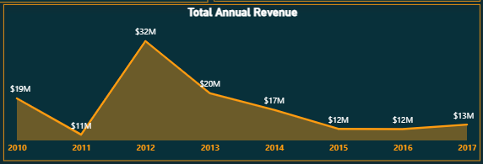

Overview of sales trends
As we can see from the dataset showing yearly revenue from 2010 to 2017, there was a sudden increase in the company’s revenue to approximately $32 million during the fiscal year 2012, with a profit of $9.21 million. However, in 2013, revenue and profit margins decreased by 36.27%, continuing to decline until 2015 before starting to recover in 2016.

Slide 5


Key Performance Indicators

Slide 6






70+
$137M+
10+
$44M+
500K+
Countries
Total Revenue
Product Types
Profit
Goods Sold
A large sale of inventory represents a significant reduction in stock, often indicating increased sales activity or a strategic move to clear out old inventory.
Profit reflects the company's operational
efficiency, strategic investments, and relentless
focus on innovation.
Product categories represents a diverse range of consumer interests and preferences, making
amazon's sales data a valuable resource for
business growth.
This monumental figure encapsulates
transactions across diverse product categories, highlighting amazon's pervasive influence on
consumer spending habits worldwide.
The sales data across these countries provides
invaluable insights into customer behaviour, market trends, and economic dynamic.
market trends, and economic dynamic.

Slide 7
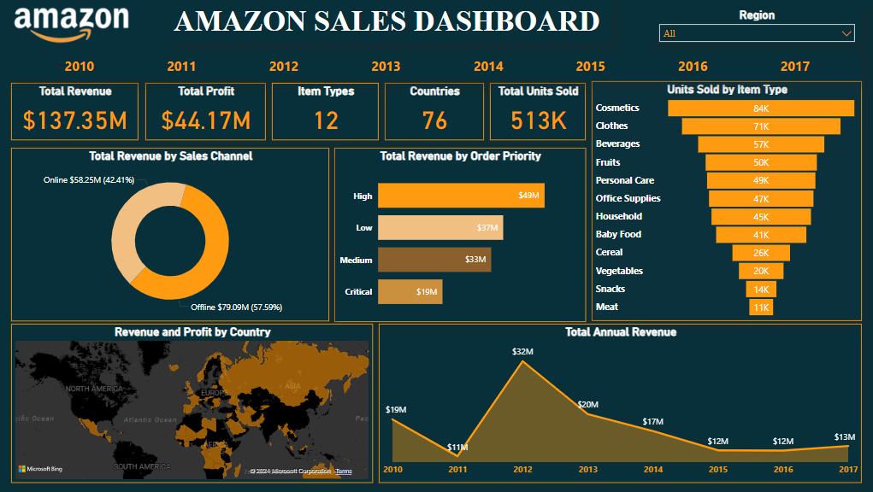

Slide 8


Key Insights

Slide 9
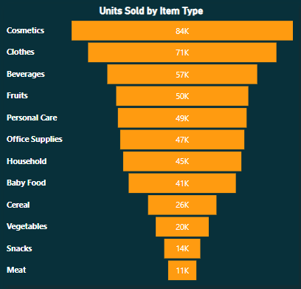
Sales by Product Type
Cosmetics is the top-selling category, followed by Clothes, Beverages, Fruits, and Personal Care. This suggests that Amazon is a strong retailer for a variety of everyday products.

Slide 10
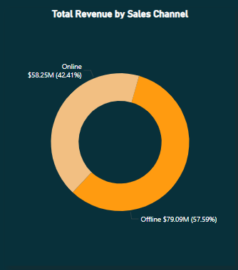
Sales by Channel
Offline sales account for a higher percentage of total revenue than online sales (57.59% vs. 42.41%). This could be due to a number of factors, such as the fact that Amazon is a relatively young company and has not yet fully saturated the online retail market. It is also possible that some consumers prefer to shop in brick-and-mortar stores for certain products.

Slide 11
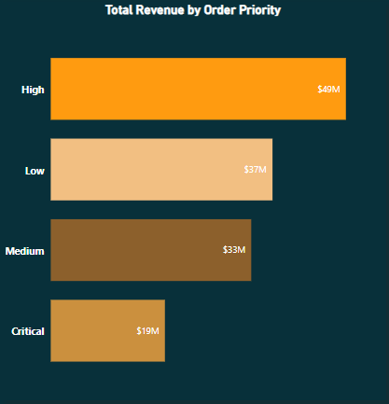
Sales by Order Priority
High-priority orders account for the largest share of total revenue (49M), followed by low-priority orders (37M) and medium-priority orders (19M). This suggests that Amazon is able to fulfill a significant number of orders quickly and efficiently.

Slide 12
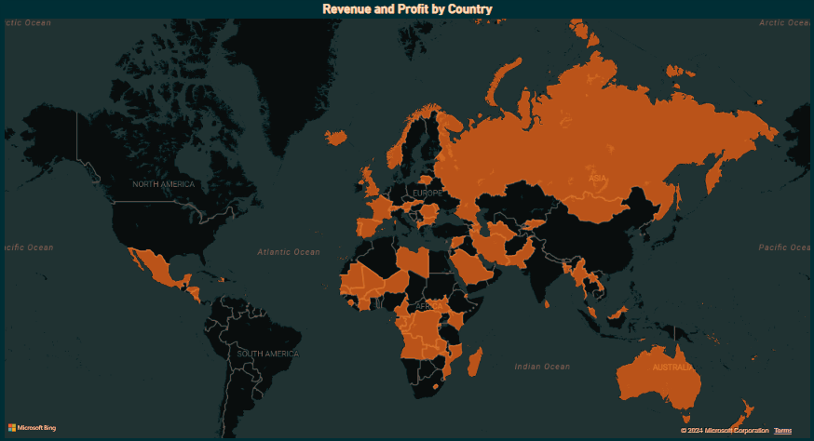
Profit & Revenue by Region
North America is the most profitable region for Amazon, followed by Europe and Asia. This could be due to a number of factors, such as higher consumer spending in North America or a more mature e-commerce market in the region.

Slide 13
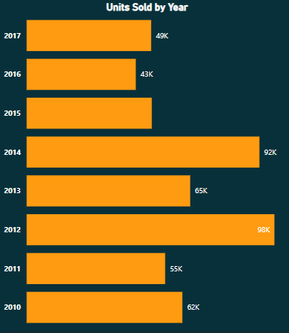
Units Sold by Year
The number of units sold by Amazon has been increasing steadily over the past few years. This suggests that Amazon is growing its market share in the online retail industry.

Slide 14

My Recommendations
01.
Quarter 1 Promotions: Introduce special offers in March, such as clearance sales or special bonanzas, and during the December Christmas season to boost revenue.
02.
Online Sales Strategies: Implement "Buy One Get One" offers and prioritize critical orders to increase customer attraction and generate higher revenue.
03.
Weekend Promotions: Highlight weekend discount sales, especially on fruits, to drive higher sales.
04.
Regional Focus: Increase promotional offers in the North American region to address low sales and revenue.

Slide 15

Presented by Ojas Chaudhary
Thank you very much!

